Slide 1
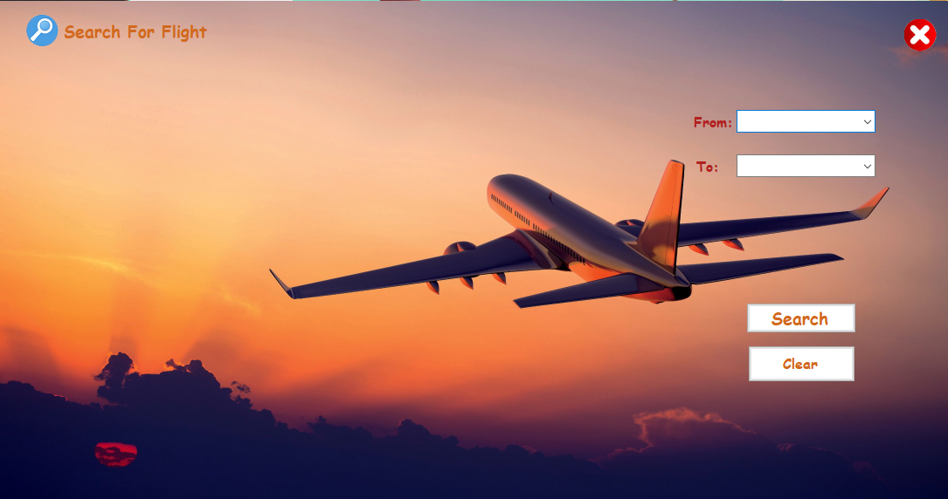
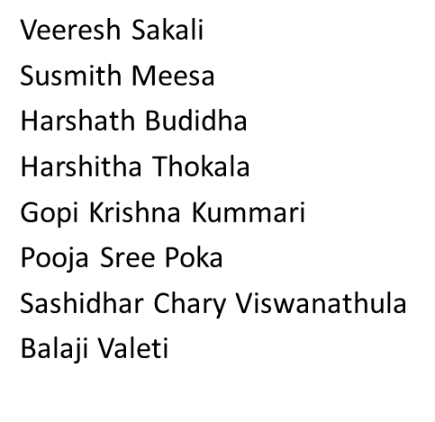
DREAMSCAPE DESTINATIONS
DREAMSCAPE DESTINATIONS
SE Project Team 02

Slide 2

Project Motivation
Project Description
Core requirements for the project
Non - functional requirements
Technologies
Unit Testing and Functional Testing(experiences)
Code inspection results and resolutions
Feedback from peer reviews
Future Scope
Conclusion
Responsibilities of individuals

Slide 3

Dreamscape embodies our shared passion for travel and exploration, driving us to create a seamless online platform where adventurers can turn their dreams into reality. With innovation and dedication at our core, we're motivated to redefine the travel experience, inspiring wanderlust and crafting unforgettable journeys for travelers worldwide. Together, we're embarking on an exciting journey to revolutionize how people discover and indulge in the beauty of our world.

Slide 4

Description
We aim to provide a perfect tour planning site where users can see the available spots and their total expenses. Users will also be able to add or remove some services from the total package i.e. food expenses, hotel type, etc. In the end, the users will make a payment to book their wonderful journey with us.
We will use the Nodes.JS Express framework for the backend and link it to the SQLite3 database. The front end will be designed on React while including Bootstrap in it.

Slide 5
Technologies
Front-end – ReactJS, Bootstrap, HTML, CSS
Back-end – NodeJS,
Database- MongoDB(coupled with Mongoose)

Slide 6
Core Requirements

Slide 7
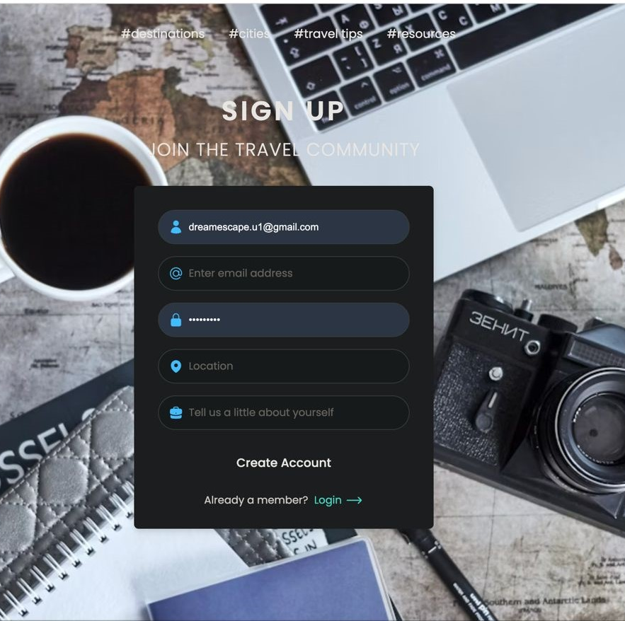
User registrations
We developed a user interface for user authentication including features like Login / Signup, and create an account if the customer new to our website.
By selecting the "Login" or "Sign In" option, which is typically placed prominently on the homepage or in the website header, current users can access the login interface.
When a new user visits the website, they are presented with a registration form.
In case of incorrect credentials, appropriate error messages are displayed, indicating the issue. We have used Django and Node.js in backend to develop this user authentication page

Slide 8
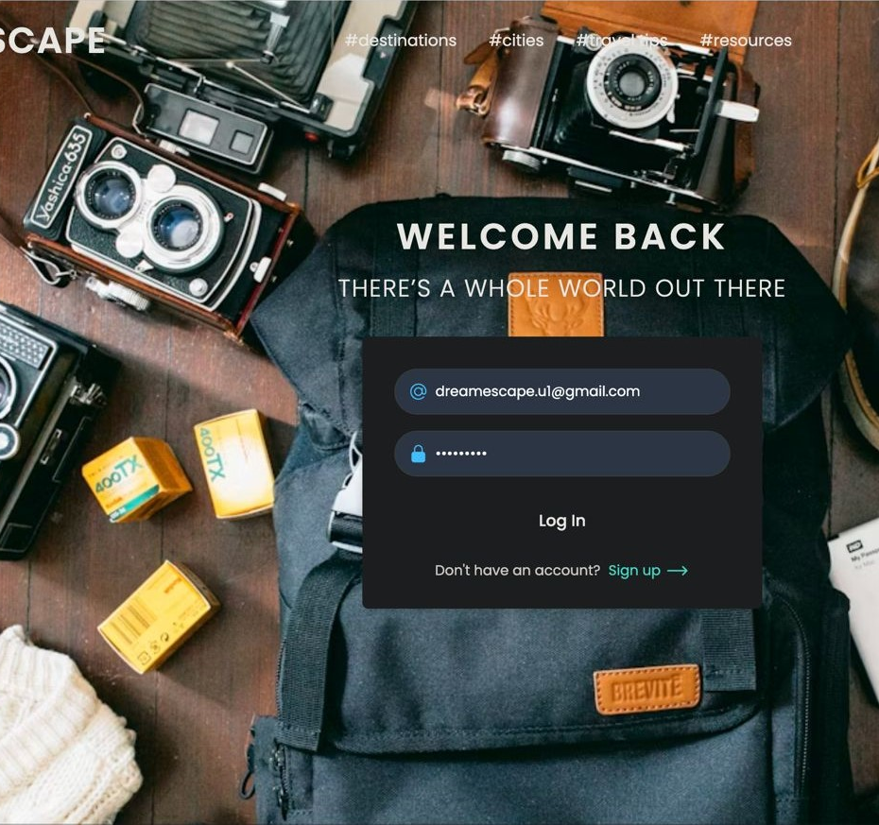
Login page
By clicking on the login button or link, current users can access the login form.The form prompts for a password and username/email.Once submitted, the credentials are checked against the database for authenticity.If the login credentials be correct, the user gets routed to either their dashboard or their chosen landing page.
Our front-end login form was structured and styled using HTML and CSS, and our back-end server-side functionality and database management were handled by Node.js and MongoDB.

Slide 9
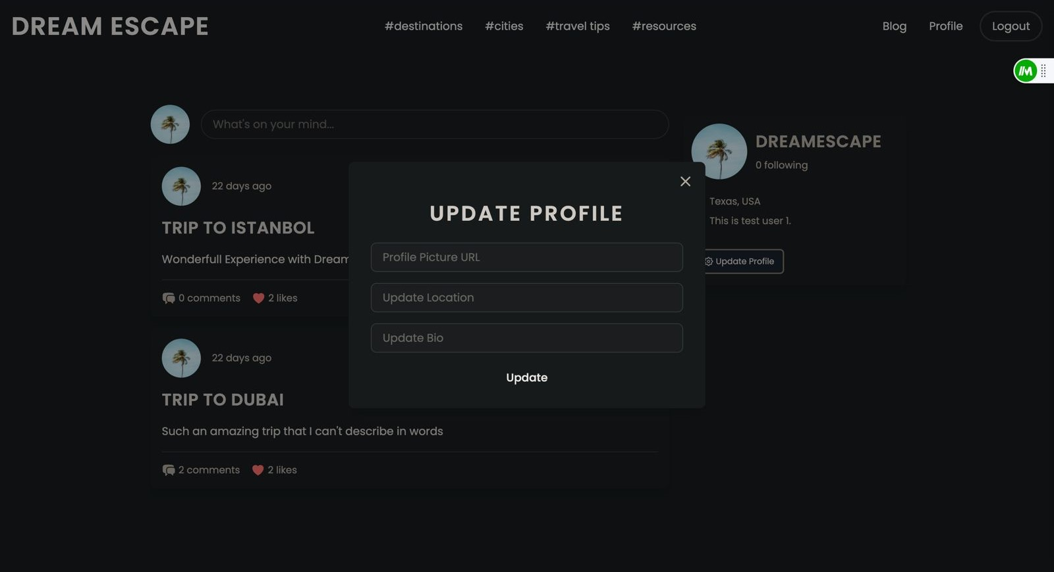
User Profile Update
Update Profile Users can access the user account selection to access the dedicated page where they manage their profile settings. Users can change their bio, location, photo, and other pertinent information.Customers are provided with the option to save their profile changes through interface button labeled "Update", facilitating easy application of modifications and return to the profile view.Java Script, Node.js, and MySQL are utilized for crafting and managing profile update requests, as well as storing profile information

Slide 10
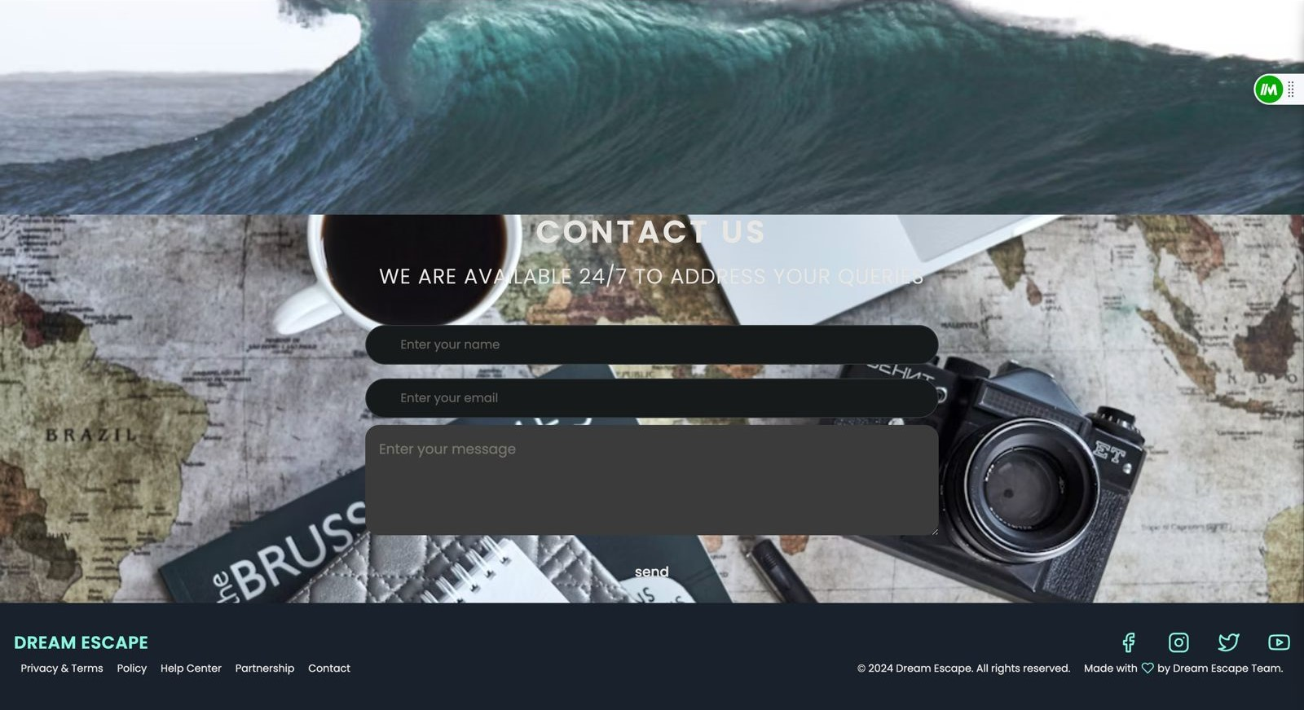
Contact form
Customers can use a contact form available from the help center to get in direct contact with customer service. Visitors usually find fields to submit their name, email address, message, and subject on the contact form.

Slide 11
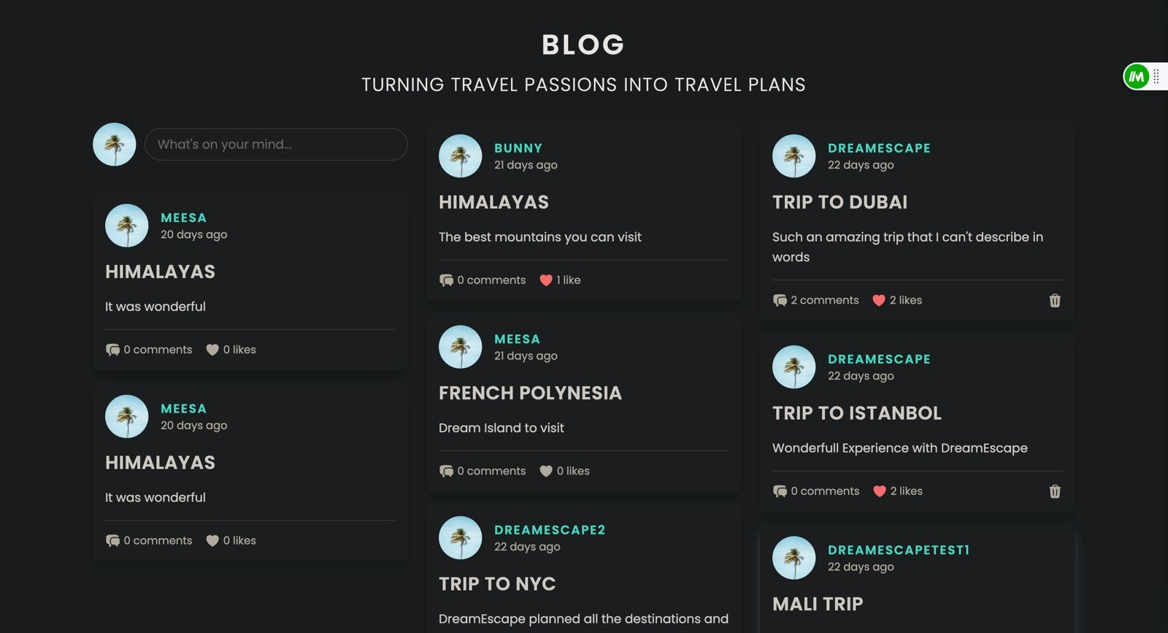
Blogs page

Slide 12
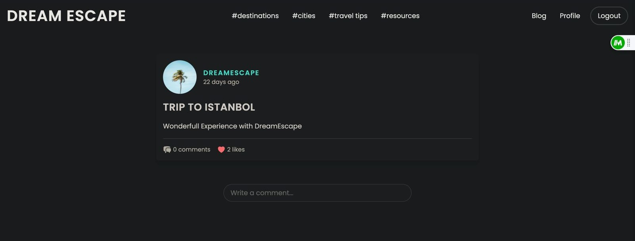
The blog homepage serves as the central hub for accessing a collection of articles, posts and customer feedback.A dedicated section within the blog showcases customer feedback, testimonials and reviews.Each testimonial may contain the name of the client, their photo (if one is available), and a succinct statement summarizing their approval or satisfaction.
Here a customer can view other customer comments, posts, like their posts and comment on their post to know more about the place.

Slide 13
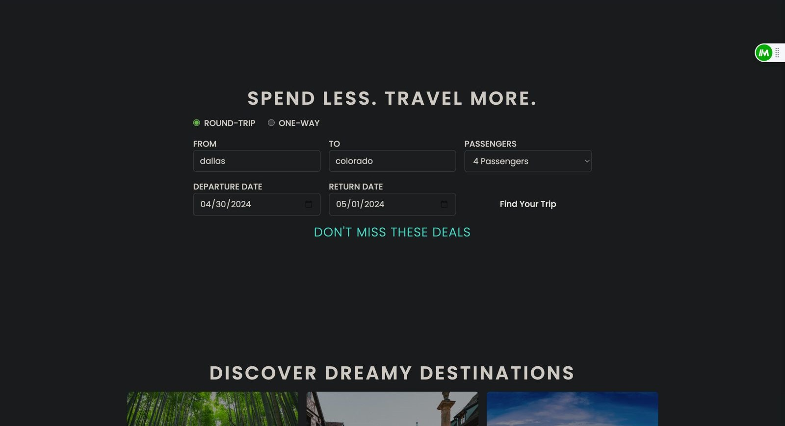
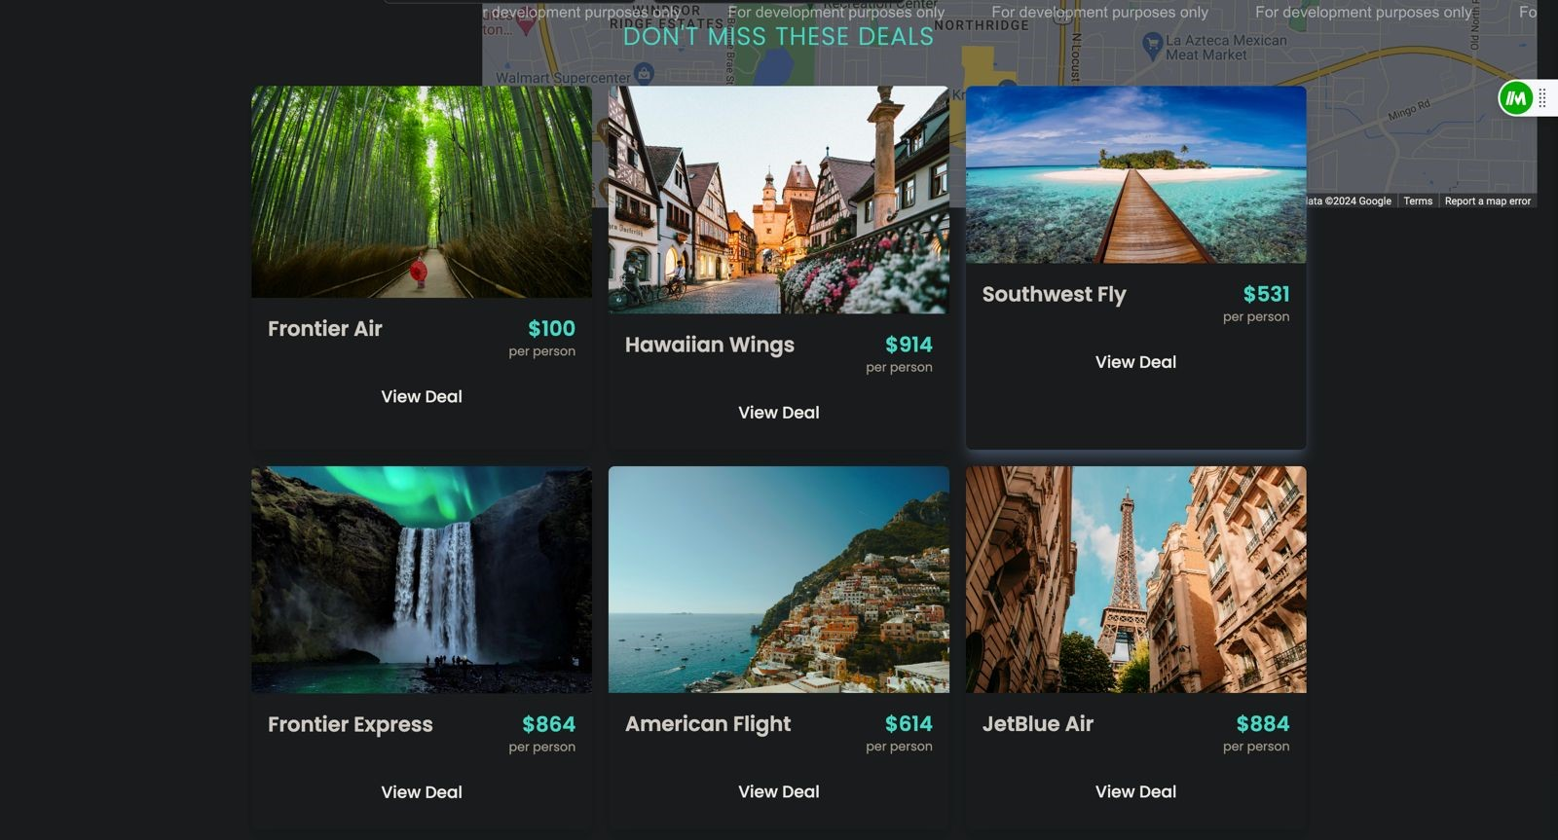
Explore Page
A search results page with relevant information is shown to users when they input a query.Usually, a title, a synopsis, and a thumbnail image (if related) are displayed with the option to see additional information for each search result.While backend technologies like PHP, Python and Node.js are used for backend tasks, features like search forms, navigation menus, and content listings are designed and made interactive with the help of HTML, CSS, and JavaScript. Search query management, category navigating, and data in databases retrieval are handled by JavaScript.

Slide 14
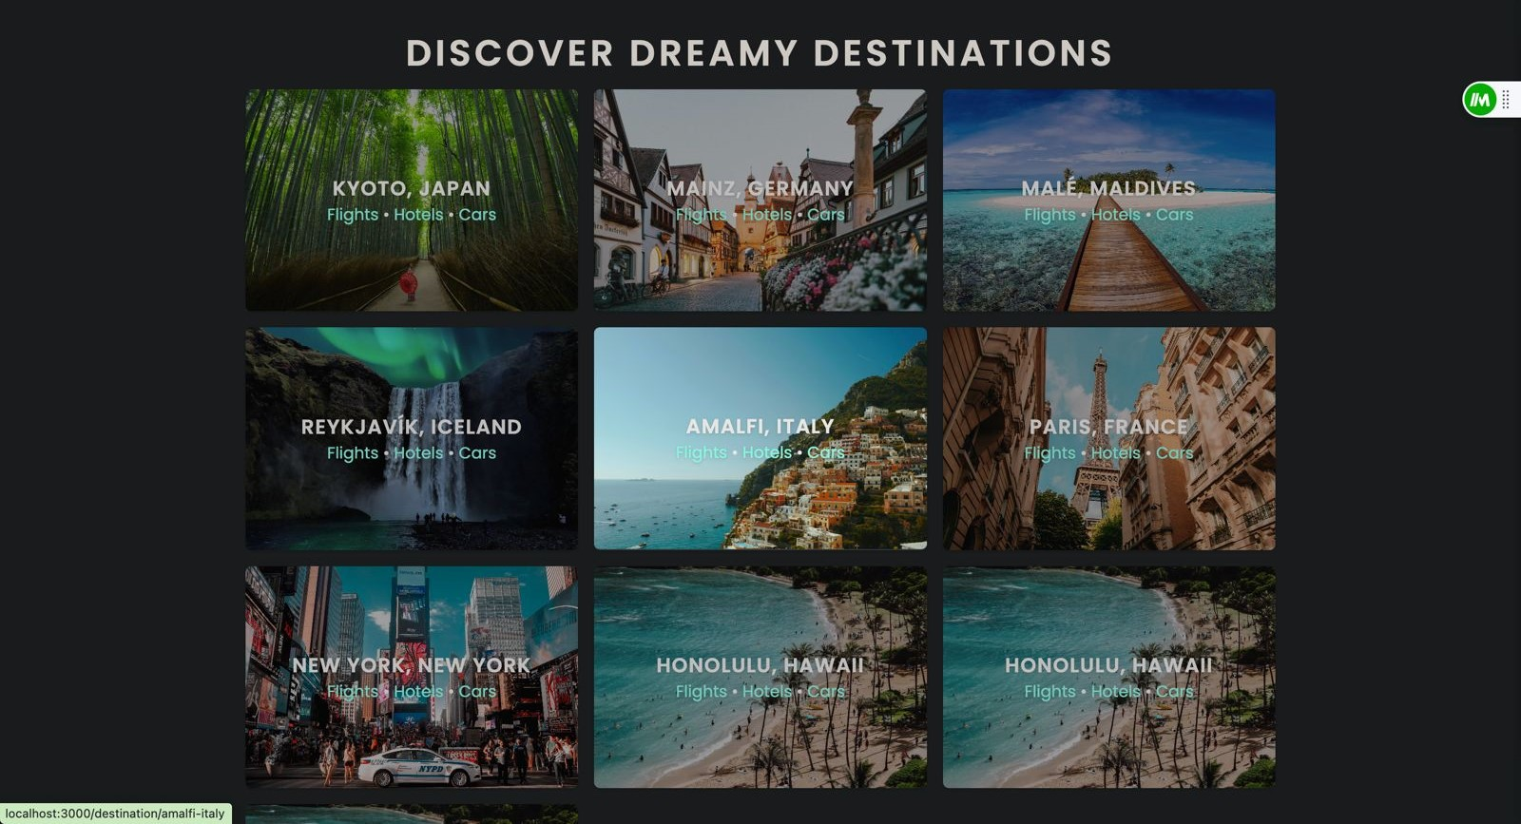
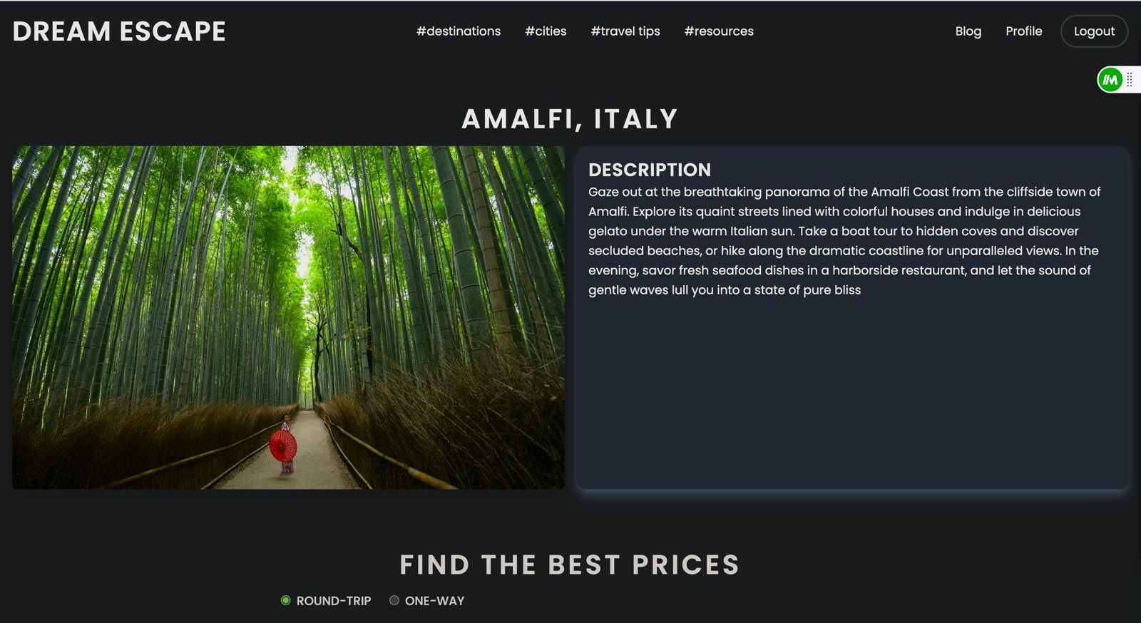

Slide 15
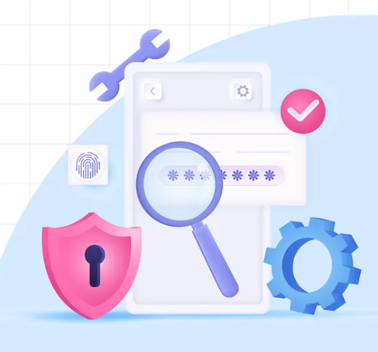
Non Functional Requirements
Security
Users’ data, including credentials and personal information, will be kept confidential during check-in and vacation. Encryption of payments will be kept to ensure secure transactions. Strategies will be implemented to prevent common security abilities such as SQL injection and cross-site scripting (XSS)
Performance
The system will be responsive and able to handle multiple simultaneous user requests with minimal delay. Pages will load quickly for a seamless experience
Scalability
The system will be designed to accommodate a growing number of users and tours. Scale-ability considerations will be taken into account at both the application and infrastructure levels.

Slide 16

Non Functional Requirements
Usability
The user interface will be intuitive and accessible. The platform will be accessible on devices such as desktops, laptops, tablets, and smartphones. The policy will prioritize user-friendly interfaces and transparency.
Compatibility
The compatibility feature ensures that the platform will be compatible with different devices, browsers, and operating systems, allowing users to easily access and use the platform across platforms and environments. Compatibility is crucial for reaching a broader audience and maximizing user accessibility.

Slide 17

Testing Experience
Both functional and unit testing have been done by us.
We evaluated various features, including sign-up, login, and home page by providing input and comparing the result to the expected output.
Backend testing included testing the database establishment, privacy policy page, and FAQ page.

Slide 18
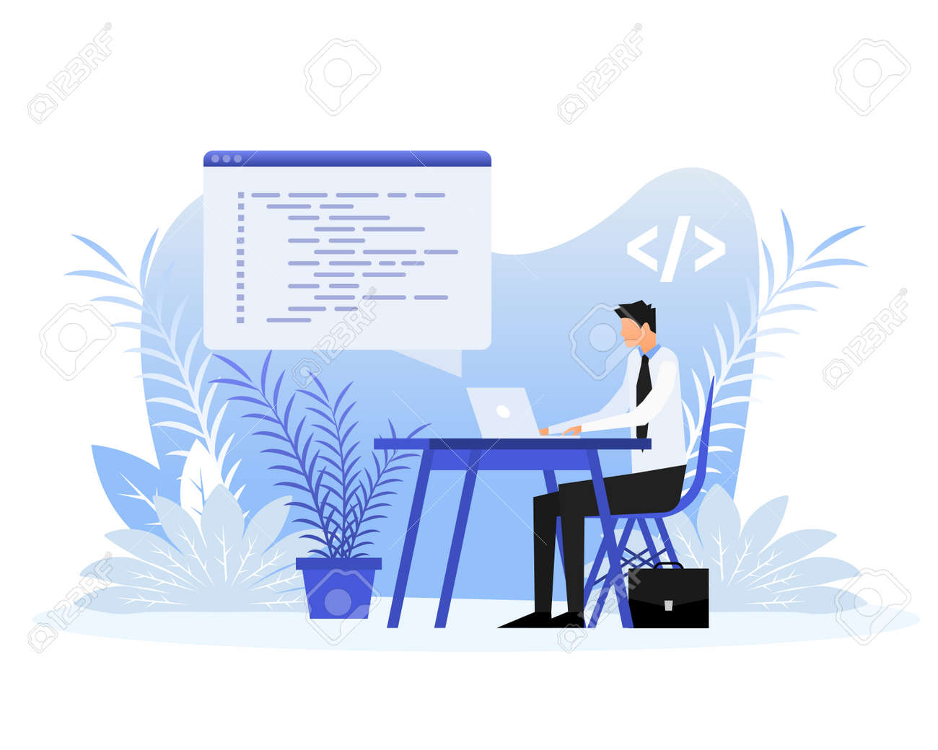
Code Inspection results and resolutions
signup and login pages work well.
User profile page updates, feedback form, and contact us form go well without any errors. Forms are implemented well using NodeJS and ReactJS.
Improvements are required in booking flights and live chat systems.

Slide 19
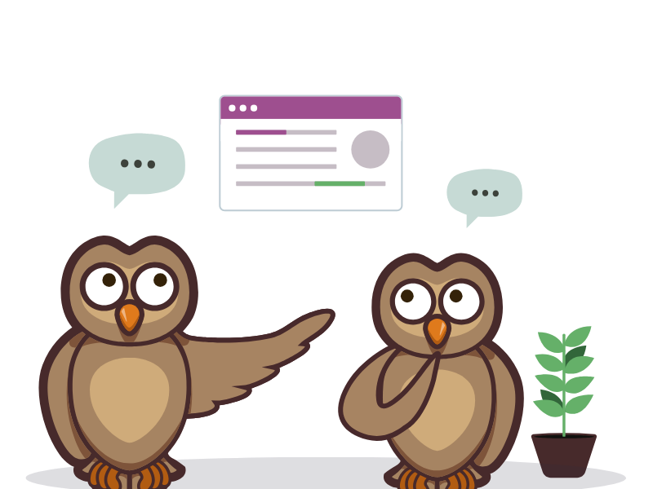
Peer Review and Feedback
Card payments
Real time updates
Discounts and coupons
Mobile friendly
LIMITATIONS
Card payments

Slide 20
Deliverables
SEO optimization
Deliverable-1
Project planning
Deliverable-2
Gathering functional & non-functional requirements
Deliverable-3
Features implementation
Deliverable-4
Additional functionalities implementation & design optimization
Deliverable-5

Slide 21
Future Scope
We can include more functionality as per the user requirements.
We want to improved our booking system, as it is the main thing which is very crucial for booking.
Not a single website is ever considered as complete because there is always some new requirement also are growing day by day.

Slide 22

CONCLUSION
Dreamscape Destinations is committed to its goal of making dreams come true and introducing tourists to the most captivating places on earth, and it keeps developing and expanding. Users are invited to embark on a voyage of discovery, inspiration, and amazement as the journey unfolds with every click, swipe, and scroll.

Slide 23
Member Contribution
Team member | Contribution
Veeresh sakali | Contributed for the front-end, especially on key pages like home, login and signup pages.
Susmith Meesa | worked on software architecture design and class diagram to understand classes and attributes. also have assisted in back-end.
Harshath Budida | worked on back-end mainly on GraphQL queries, mutations and authentication model.
Harshitha Thokala | worked on booking page and details page for places in front-end.
Pooja Sree Poka | Worked on back-end part mainly on Blogs/Feedback and Contact form.
Gopi Krishna Kummari | Responsible to setup git hub repositories, and ReadMe Files. Also, front-end part Blogs/feedback reactions and Contact form.
Sashidhar Chary Viswanathula | Worked on ,sequence diagram which is useful for understanding the flow.
Balaji Valeti | Worked on use case diagram which is a successful method for defining and arranging functional needs also on the software architecture design.

Slide 24


Thank you
Mirjam Nilsson​
mirjam@contoso.com
www.contoso.com

